Slide 1
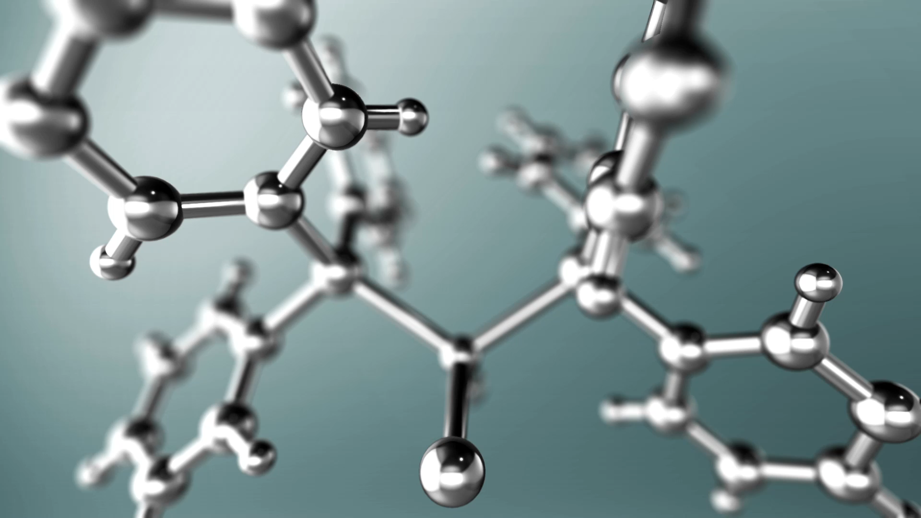
Clustering Algorithms
Eyad Kathir

Slide 2
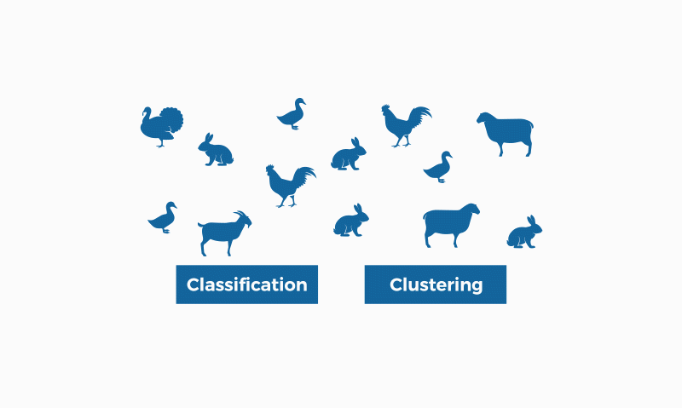
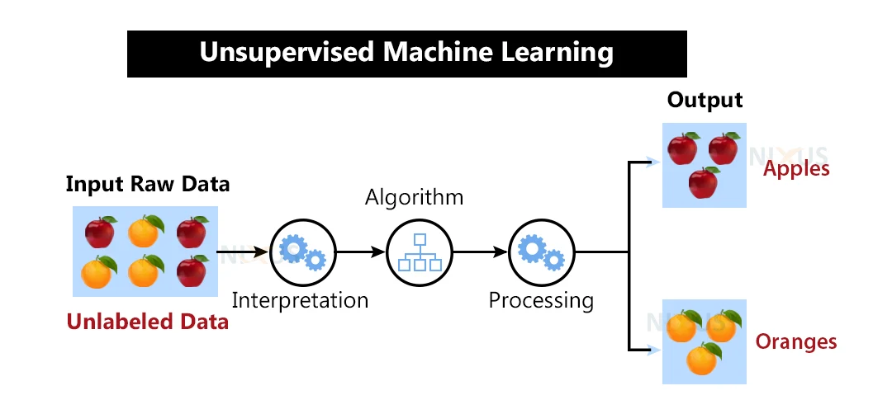
What is Clustering?
Clustering relies on unsupervised machine learning If the examples are labeled, then clustering becomes classification
Notes:
Clustering is used in projects for companies that want to find common aspects within their customers to apply customer segmentation, create customer journey maps or find groups and focus products or services. Thus, if a significant percentage of customers have certain aspects in common (age, type of family, etc.) the company can justify a particular campaign, service or product. Clustering is also useful to obtain general insights and information.

Slide 3
Types of Clustering
Centroid-based Clustering (K-means)
Density-based Clustering(DBSCAN)
Hierarchical Clustering

Slide 4
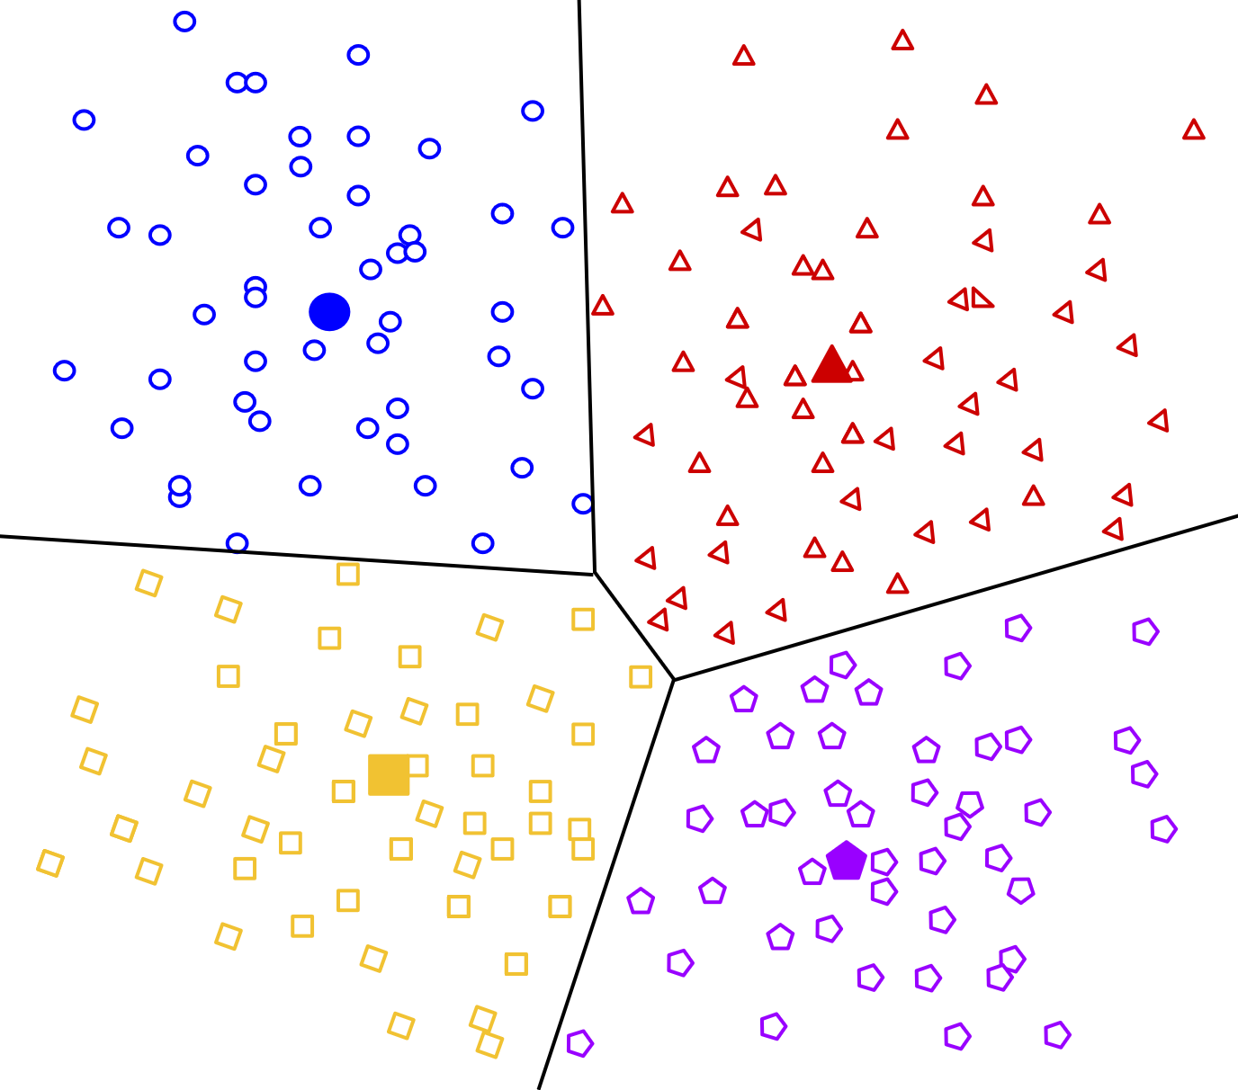
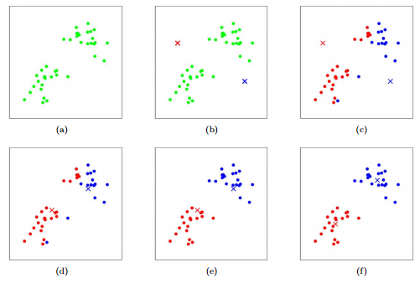
Centroid Clustering(K-means)
Most used clustering technique
Number of clusters MUST be provided
Time Complexity Best Case O(n)
Worst Case O(n^2)
Best used when clusters # known, used in customer segmentation, image/data compression

Slide 5
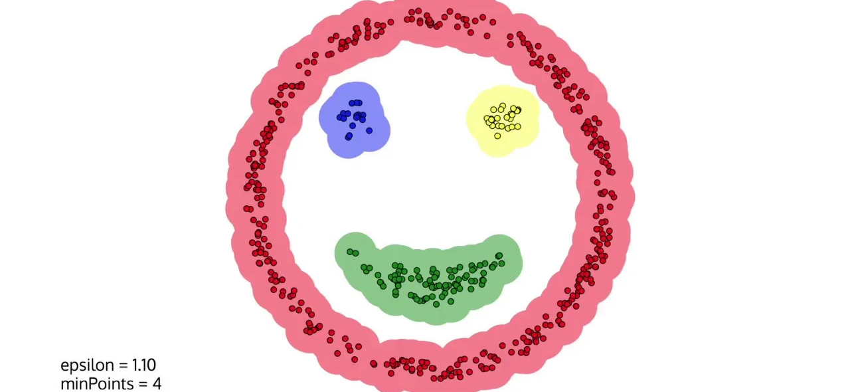
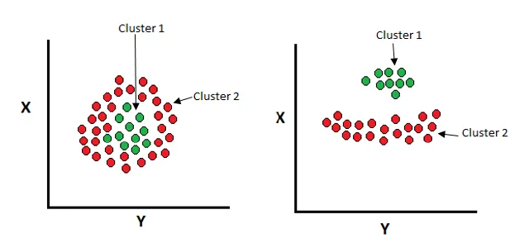
Density based algorithm (DBSCAN)
The DBSCAN algorithm separates the areas of high density from the low-density areas.
Number of clusters doesn’t need to be provided (no k-means)
It automatically identifies the clusters based on the density
Time complexity Best O(n) Worst O(n^2)
Best used in spatial data analysis

Slide 6
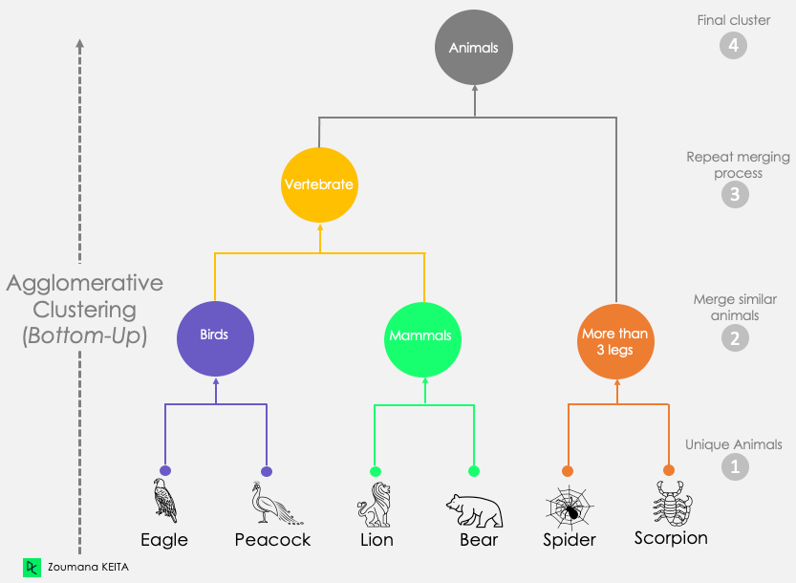
Hierarchical Clustering
Each data point is initially regarded as a single cluster and gradually merged in the method
known of being the one that makes “MOST SENSE”
The best case can approach O(n log n)
Worst case can get to O(n^2)

Slide 7
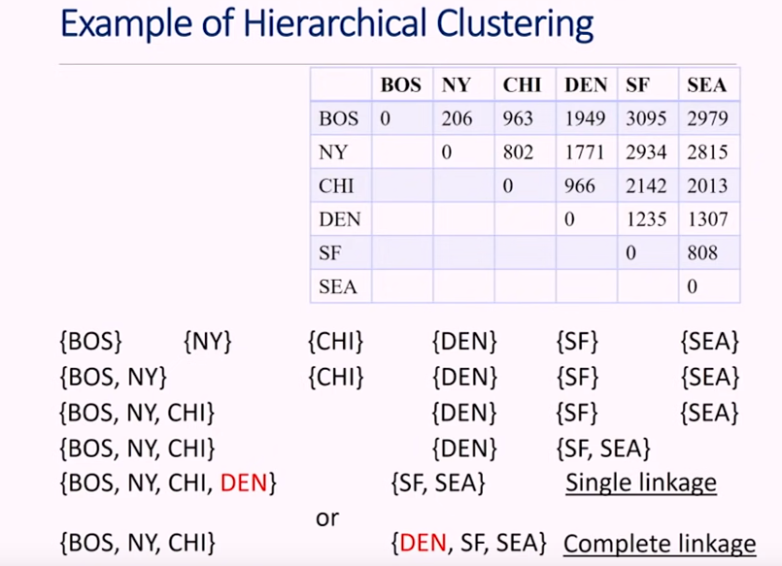
Traveling Scenario
Single linkage: the distance between one cluster and another cluster to be equal to the shortest distance.
Complete linkage: the distance between one cluster to another to be equal to the greatest distance.
Average linkage: the distance between one cluster to another to be equal to the average distance.

Slide 8
Algorithm | Pros | Cons
K-Means | - Simple and easy to implement Efficient for large data sets | -Sensitive to initial centroids -Requires specifying the number of clusters (K)
DBSCAN | -Can find arbitrarily shaped clusters - Doesn’t require specifying the number of clusters | -Effective for identifying clusters with varying shapes and sizes BUT it may struggle to distinguish between regions of different densities -Difficult to choose appropriate parameters
Hierarchical Clustering | - Doesn’t require specifying the number of clusters -Provides a dendrogram that can help understand the data | - Computationally expensive for large data sets -Noisy data can lead to incorrect clusters

Slide 9
References
https://www.youtube.com/watch?v=esmzYhuFnds&t=868s
https://www.slideteam.net/clustering-algorithms-in-machine-learning-training-ppt.html#images-2
https://stanford.edu/~cpiech/cs221/handouts/kmeans.html

